Slide 1
Foreshock Significance in Generation of ULF Waves
Alex Angelo
Mentor-Olga Gutynska

Slide 2
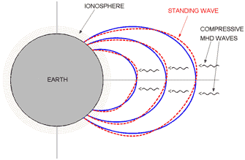
ULF Waves
IONOSPHERE
STANDING WAVES
AKA Magnetic Pulsations
1 mHz to 1 Hz
Pc versus Pi
Variety of events thought to be energy inputs
Kevin-Helmholtz Instabilities
Reconnection
Flux Transfers
ULF WAVES
EARTH

Slide 3
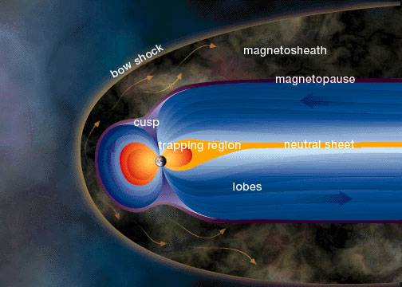
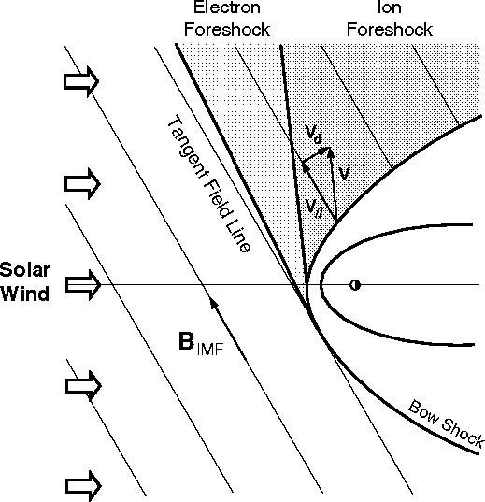
Ion Foreshock

Slide 4
Importance of ULF Waves
Oscillations in the magnetosphere disturb the ionosphere
Effect the total electron count (TEC) fluctuations (0.005% to 0.1%)
While often regarded as insignificant for high frequency EM signal propagation, with improving resolution/signal ULF oscillation becomes detectable
Over-the-horizon radar, GPS, magnetic anomaly detection
Preventing future improvements
Constant noise
Radio astronomy – LO-FAR
Understand what’s happening in space

Slide 5
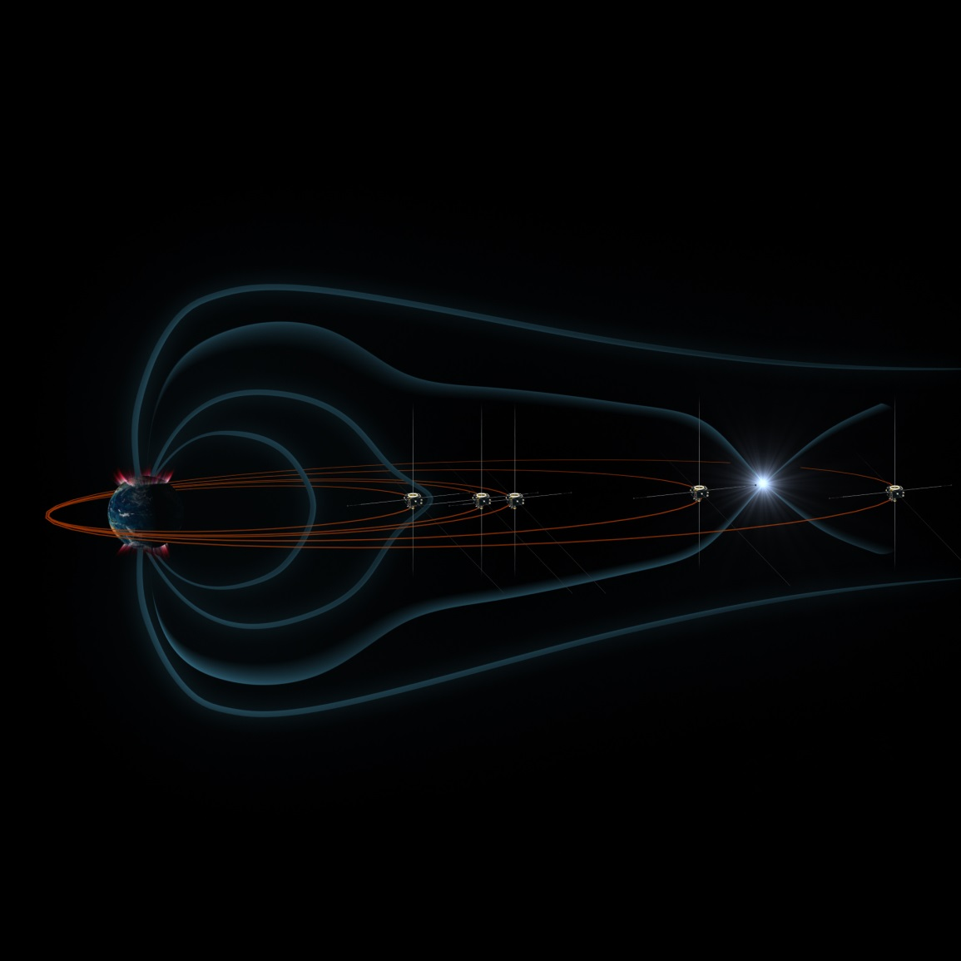
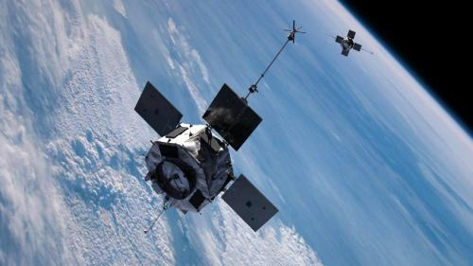
Methods

Slide 6
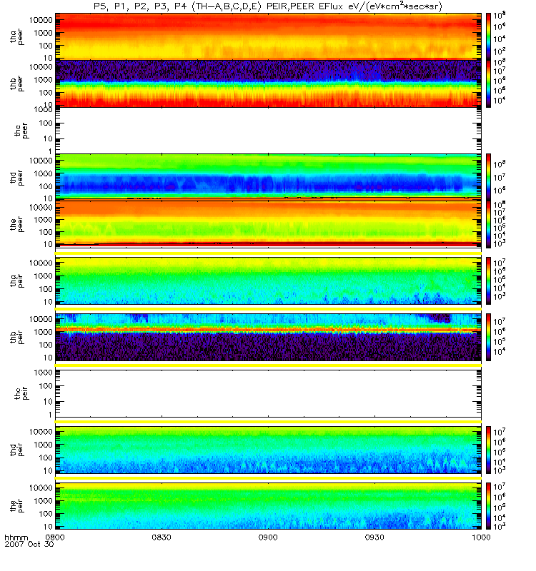
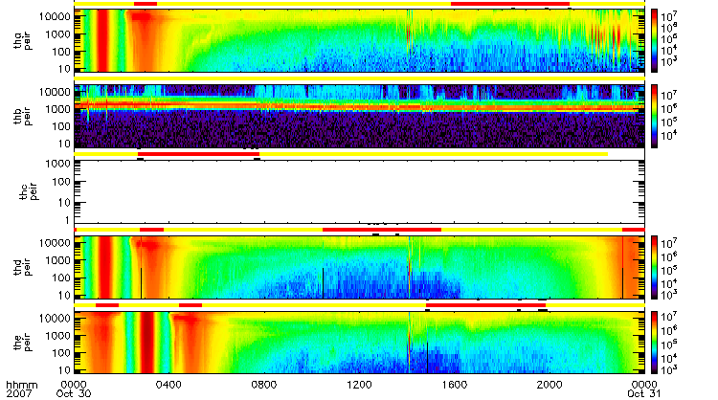
Start of interval
End of interval
10/30/07

Slide 7
10/30/07

Slide 8
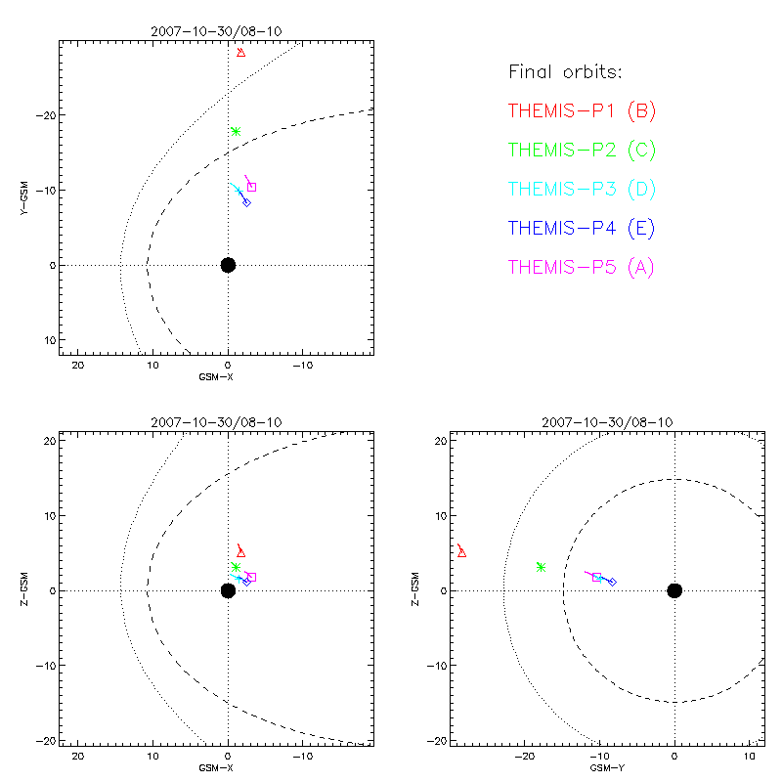
10/30/07

Slide 9
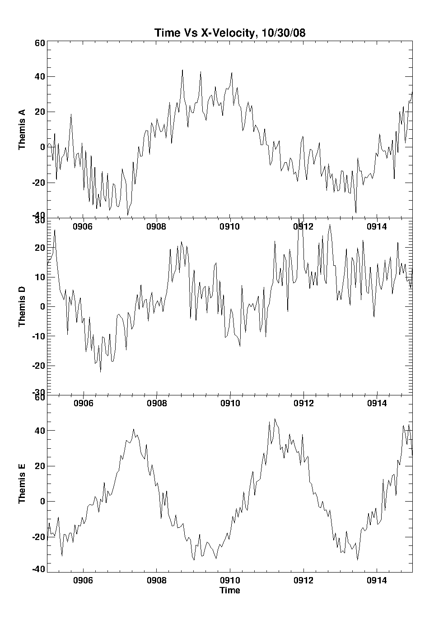
FFT
Broke intervals into ten minute or one hour intervals
Looked at Moments for x-components of velocity
Looked at ESA for magnetic fluctuations
Preformed Fast Fourier Transformation to find frequency and hence period
Calculated periods
A: 299.35895 s
D: 200.06446 s
E: 199.89372 s

Slide 11
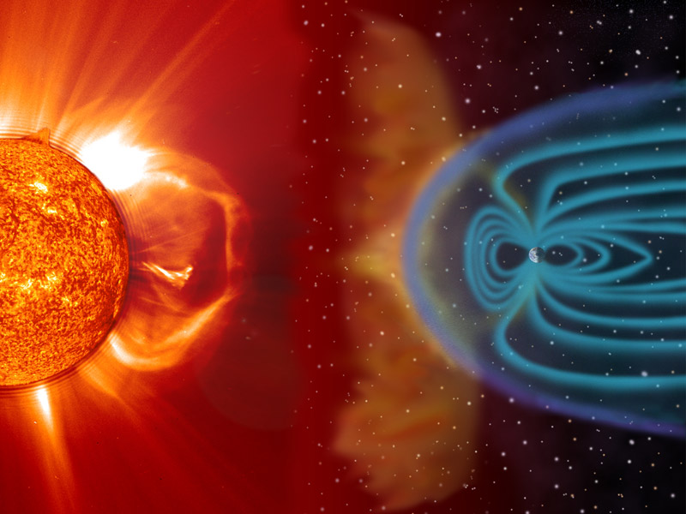
Period Averages
Solar Wind: 208.792
Magnetosphere: 267.419

